Slide 1
Learning Goals
Explore how Genetically Modified foods are made
Extract DNA from GMO foods and Run a PCR
Explore PCR
Interpret results from PCR on GMO samples

Slide 2
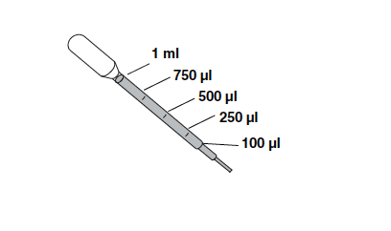
Biomedical Basic Laboratory Skills
Pipetting
  Transfer pipet
    Practice
  Micropipet
    Practice
Sterile Technique & making a streak plate
Casting Gels
Gel Loading

Slide 3
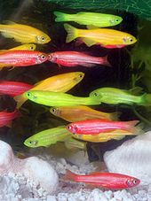
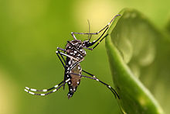
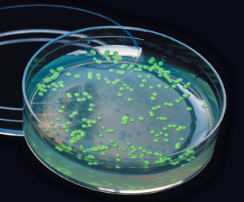
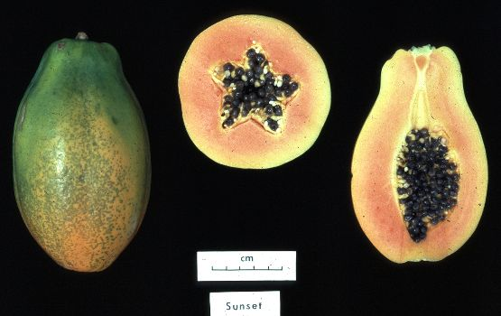
What is a GMO?
GMO = Genetically Modified Organism
Any organism whose genetic material has been altered using genetic engineering techniques. GMOs may be bacteria, yeast, insects, plants, animals, etc.
Notes:
(L to R): pGLO bacteria (E. coli transformed with GFP from jellyfish)
Glofish – GM zebrafish
Yellowfever mosquito that spreads Dengue fever – GM mosquitos (male) need tetracycline to develop into adults – without tetracycline, they die as larva (tests in Caymans showed wt mosquito populations dropped by 80% when GM mosquitos were released).
Hawaiian papaya – GM papaya was developed so that it was resistant to ringspot virus – 80% of Hawaiian papaya crop is GM

Slide 4
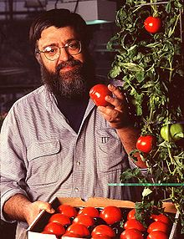
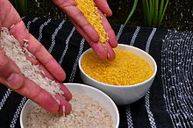
GMO Crop Timeline - highlights
1995: Canola (modified oil composition); Bt corn, Bt cotton, Bt potatoes, glyphosate resistant soybeans, virus-resistant squash
2000: Golden Rice (increased Vit. A)
1997: PRSV-resistant papaya
1994: Flavr Savr tomato (delayed ripening)
Notes:
Flavr Savr – GM to slow ripening – added anti-sense gene to interfere with an enzyme that degrades pectin in the cell walls (which causes fruit to soften). Did not sell well due to flavor – pulled shortly after.
PRSV= papaya ring spot virus – nearly decimated Hawaiian papaya population

Slide 5
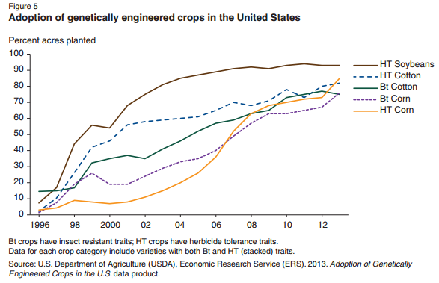
Percent of Acres planted with GM Crops
Notes:
Between 1996 and 2011, the total surface area of land cultivated with GM crops has increased by a factor of 94. 10%

Slide 6
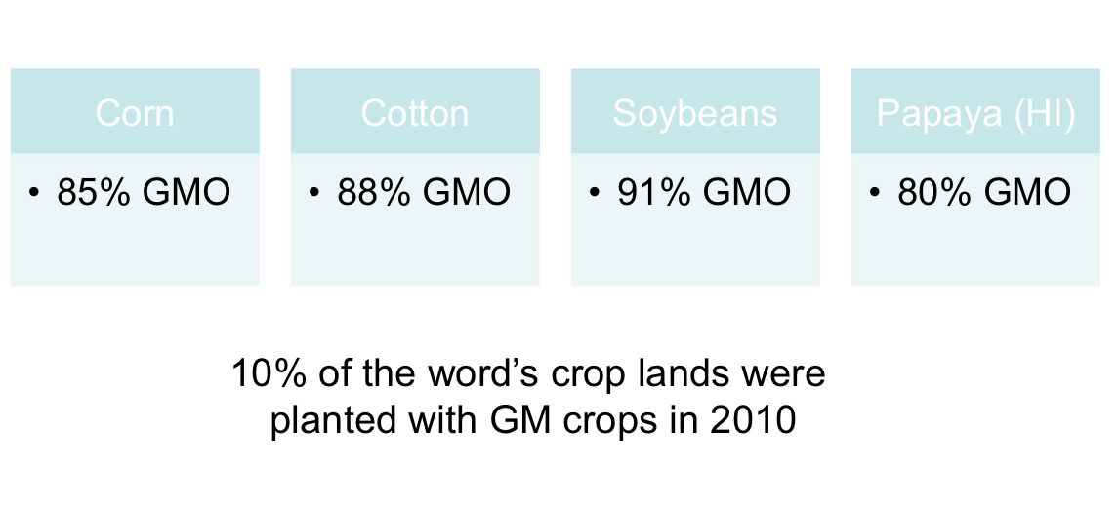
Prevalence of GMO crops

Slide 7
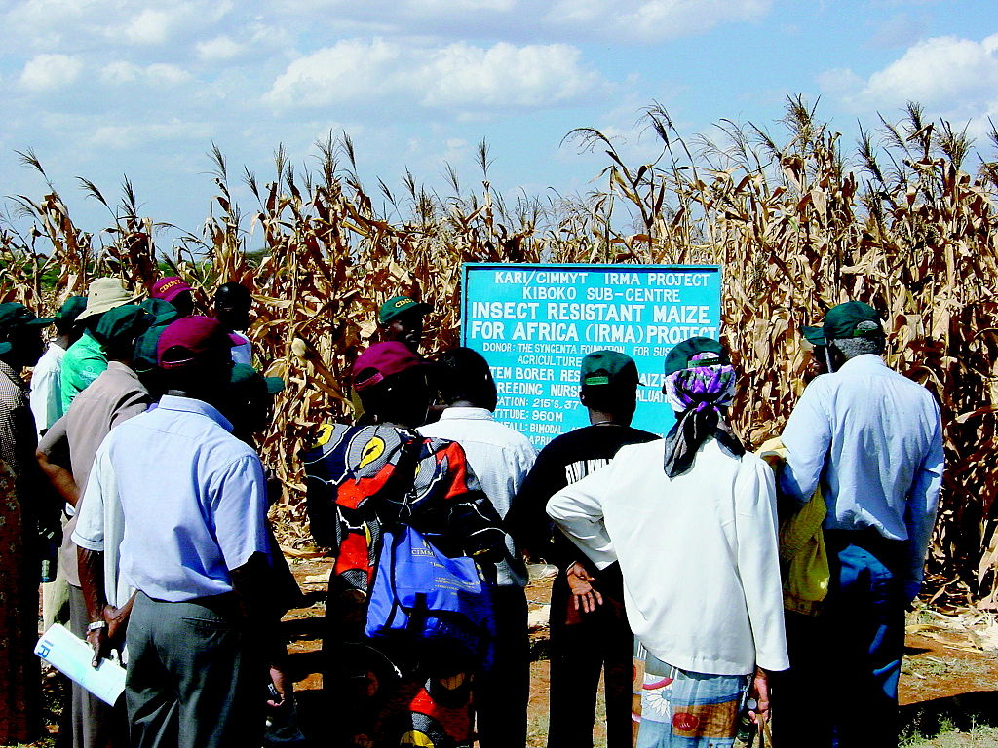
GMO Debate: Why do we have GM crops?
Growing human population
Loss of farmable land
Remediation of soil
Enrich nutrient content
Bt corn in Kenya

Slide 8
GMO Debate:
Proponents argue
Creation of super pests
Creation of super weeds
Loss of biodiversity
Biotechnology companies control agriculture
Health concerns

Slide 9
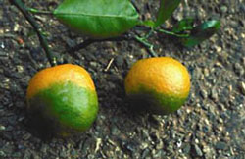
GMO Goals
Pest resistance
Herbicide tolerance
Viral resistance
Drought resistance
Cold resistance
Increased nutritional value
Improved fruit
Production of biofuels
Bioremdiation
Citrus greening disease on mandarin oranges
Notes:
Pest resistance = Bacillus thuringiensis (Bt), cry delta endotoxin (protein);
Herbicide resistance = RoundUp Ready, glyphosate tolerance, 5-enolpyruvylshikimate-3-phosphate synthase (EPSPS), from agrobacterium.
Drought resistance = C4 plants, stomata that close to minimize water loss.
Increased Nutritional Value = Golden Rice, beta carotene. Canola oils
Improved fruit = Flavr Savr tomatoes, delayed softening. Altered Ripening = malin (ethylene precursor; plant hormone).

Slide 10
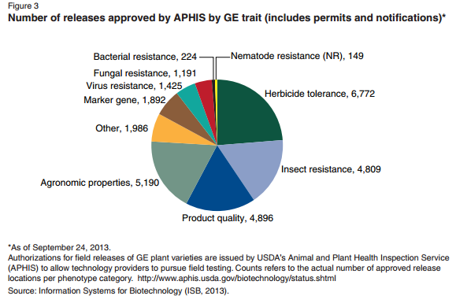
GMO Goals
Notes:
Pest resistance = Bacillus thuringiensis (Bt), cry delta endotoxin (protein);
Herbicide resistance = RoundUp Ready, glyphosate tolerance, 5-enolpyruvylshikimate-3-phosphate synthase (EPSPS), from agrobacterium.
Drought resistance = C4 plants, stomata that close to minimize water loss.
Increased Nutritional Value = Golden Rice, beta carotene.
Improved fruit = Flavr Savr tomatoes, delayed softening. Altered Ripening = malin (ethylene precursor; plant hormone).

Slide 11
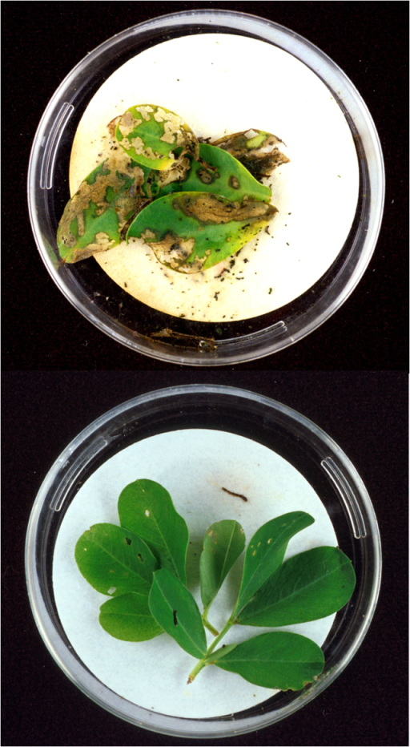
Making GMOs – 1) Choose Desirable Trait
  EX: Glyphosate resistance (Roundup Ready) – Glyphosate kills plants by interfering with amino acid synthesis. Some Agrobacterium are resistant to glyphosate – clone that gene and transfect into soybeans.
  EX: Bt (Baccilus thuringiensis) plants – Bt is a bacterium that lives in the soil and is insecticidal. It forms crystals of delta-endotoxin (called crystal proteins, encoded by cry genes on plasmid). When insects ingest toxin crystals, pores are formed in their guts – insect starves to death.
Bt toxins in peanut plant (bottom) protect it from the European corn borer larva.
Notes:
What do you need to do to make a GMO? Entire process can take 5-15 years.
Maize line Bt11 was developed through a specific genetic modification to be resistant to attack by European corn borer (ECB; Ostrinia nubilalis), a major insect pest of maize in agriculture. The novel variety produced the insecticidal protein, Cry1Ab, derived from Bacillus thuringiensis subsp. kurstaki (B.t.k.) HD-1 strain. Delta-endotoxins, such as the Cry1Ab protein expressed in Bt11, act by selectively binding to specific sites localized on the brush border midgut epithelium of susceptible insect species. Following binding, cation-specific pores are formed that disrupt midgut ion flow and thereby cause paralysis and death. Cry1Ab is insecticidal only to lepidopteran insects, and its specificity of action is directly attributable to the presence of specific binding sites in the target insects. There are no binding sites for delta-endotoxins of B. thuringiensis on the surface of mammalian intestinal cells, therefore, livestock animals and humans are not susceptible to these proteins. (www.agbios.com)
Technically safe to eat, so only those organisms that eat corn only would be affected by this endotoxin
How does round-up work? It block the ability to manufacture a specific AA, therefore (like in JP/Lysine) will kill off the plant by lacking that essential AA.

Slide 12
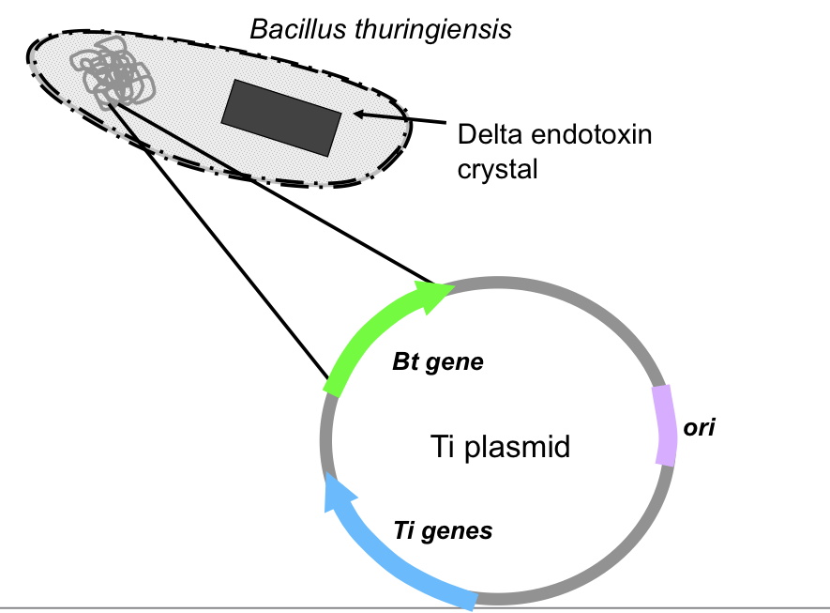
Making GMOs – 2) Clone the gene
Notes:
Ti plasmid from agrobacterium
Gene is first be localized within an organism's genome; then it must be copied so that it can be isolated or cloned out of the organism. Although a gene's coding region may just be a few hundred or thousand base pairs long, the gene itself may be tens of thousands of base pairs long, due to its introns (noncoding sequences). The cloning of an entire gene can be very laborious and can take many years.

Slide 13
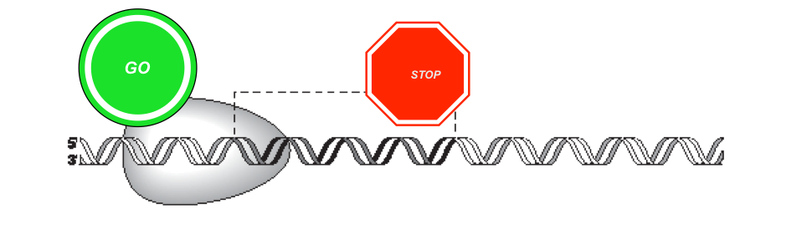
Making GMOs – 3) Remove introns. Add promoter and terminator
Streamline the gene
Introns: non coding sequences
Promoters-signal where RNA should start transcribing the gene
Terminators- Signal where to stop transcribing the gene
Notes:
the third step is to engineer the gene so that the crop plant's cells will read it correctly and manufacture the protein of interest. This is done by streamlining the gene to remove unnecessary introns, and adding or changing sequences that will enable the gene to be expressed within the crop's cells, including a promoter and a terminator (see Figure 1). The promoter serves as a docking site for RNA polymerase and a signal for where it should start transcribing a gene. The terminator is the signal to stop transcription.

Slide 14
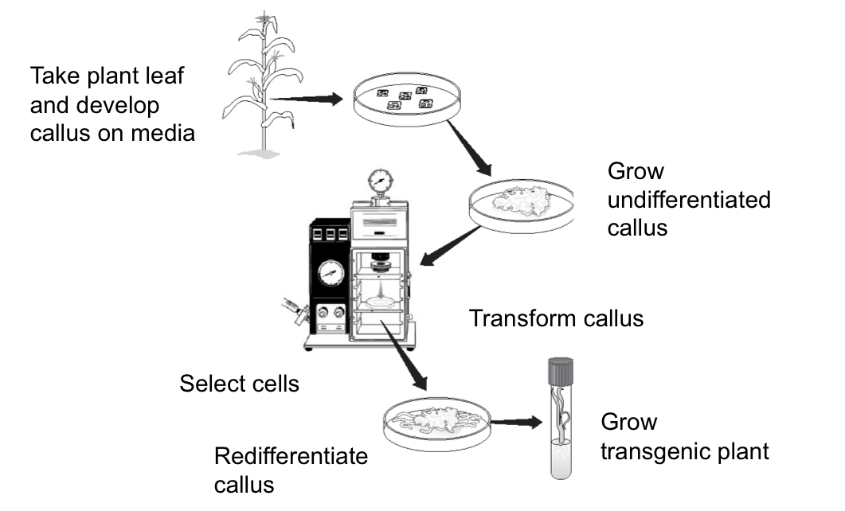
Making GMOs – 4) Transform plants
Notes:
Take plant leaf sample, break up and develop callus on media. Callus is mass of undifferentiated cells. Transform using gene gun or other methods. Grow callus on selective media for transformants, transfer to growth media…becomes plant. Other methods, electroporation, agrobacterium, whiskers. Totipotent property of plants.
Helios: bind the plasmids to Au and shoot it into the plant. Shoot, grow and see if its genetically modified,

Slide 15

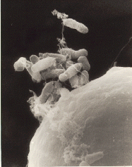
Making GMOs – Getting DNA into plants
  Gene gun – DNA is bound to tiny gold particles and shot into plant cells. DNA separates from the gold and is integrated into the plant genome.
  Agrobacterium tumefaciens mediated transformation – Agrobacteria are natural plant parasites (cause crown gall) that insert their plasmid genes into plant hosts. The Agrobacteria DNA is inserted in a random site in the plant genome.
Agrobacterium tumefaciens beginning to infect a carrot cell.

Slide 16
Why test for GMO’s?
Legislation
  US and Canada – no labeling requirement
  EU: food labeled “GM” if >0.9% GM
  Japan: food labeled “GM” if >5%

Slide 17
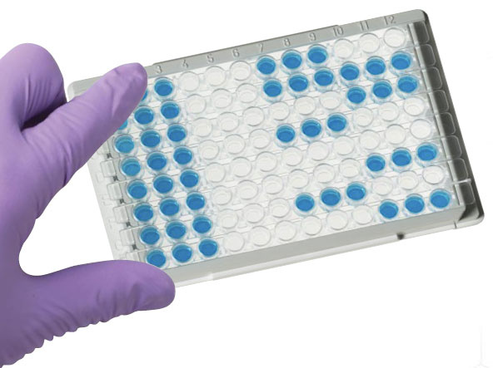
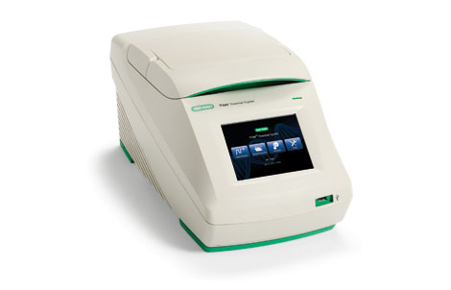
How to test for GMOs
ELISA: Test for presence of proteins expressed from genetic modifications.
Pros: cheap, fast, low tech
Cons: only for fresh food (proteins denatured when processed). Crop specific.
PCR: Test for presence of inserted foreign DNA
Pros: can ID different GM crops. DNA very stable, even when processed or old.
Con: expensive, time-consuming
Notes:
ELISA used only for fresh food (cheaper, faster). Photosystem II gene that all plants have: use as test for viable plant DNA.
There is also ELISA test for GMO.

Slide 18
How to test for GMOs
Test for GMOs by PCR:
Grind food
Extract DNA from sample
Test sample DNA for viable plant DNA
Test sample DNA for genetic modifications
VERY IMPORTANT- Use sterile technique so as not to contaminate samples!!!!

Slide 19
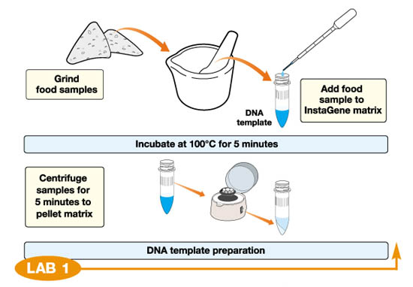
Prepare samples for PCR (by 11)

Slide 20
What do you need for PCR?
Template - the DNA to be amplified
Primers - 2 short specific pieces of DNA whose sequence flanks the target sequence
    Forward
    Reverse
Nucleotides - dATP, dCTP, dGTP, dTTP
Magnesium chloride - enzyme cofactor
Buffer - maintains pH & contains salt
Taq DNA polymerase – thermophillic enzyme from hot springs

Slide 21
How does PCR work?
Heat (94oC) to denature DNA strands
Cool (59oC) to anneal primers to template
Warm (72oC) to activate Taq polymerase, which extends primers and replicates DNA
Repeat 40 cycles
Notes:
Reads 3-5 and writes 5-3. Importance of the 3’. Like AZT….terminate nucleotides.
You need new primers. Millions of copies of primers. Etc… 3rd cycle is the first time we see product only. So now, each cycle you duplicate. Now go home and teach mom/dad. All this is on-line. Flash animations etc…

Slide 22
How does PCR work?
Notes:
Reads 3-5 and writes 5-3. Importance of the 3’. Like AZT….terminate nucleotides.
You need new primers. Millions of copies of primers. Etc… 3rd cycle is the first time we see product only. So now, each cycle you duplicate. Now go home and teach mom/dad. All this is on-line. Flash animations etc…

Slide 23
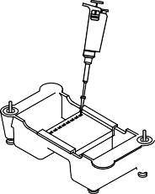
Back to GMO-
Electrophoresis
Notes:
Bill Nye netflix gmo video Bill Nye saves the world.

Slide 24
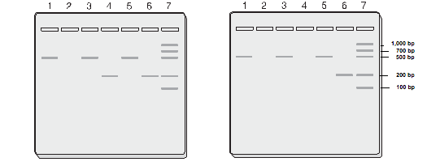
Load Gel for Electrophoresis

Slide 25
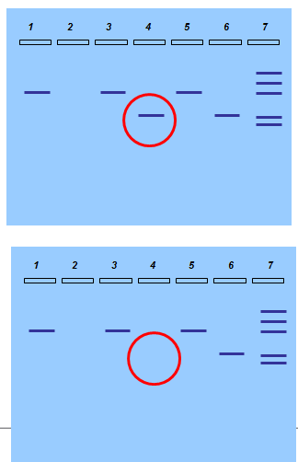
Result Analysis
Non-GMO food with plant primers
Non-GMO food with GMO primers
Test food with plant primers
Test food with GMO primers
GMO (+) DNA with plant primers
GMO (+) DNA with GMO primers
PCR MW Ruler
GMO Positive
GMO Negative

Slide 26

Analyze Results
-1000-bp
-700 bp
-500 bp
-200 bp
-100 bp
Molecular weight ruler (lane 7) allows the size of the DNA bands to be determined

Slide 27

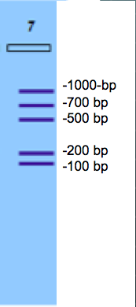
Analyze Results
Lane 1 - band at 455 bp tells us that plant DNA was successfully extracted from the non GMO food.
*** If no band is visible, what does that tell us?
Lane 2 – non GMO was treated with a primer found in GMO crops and so a band should only show up if the food is GMO.
****What would a band here tell us?

Slide 28

Analyze Results
Lane 3 Test food band at 455 bp tells us that plant DNA was successfully extracted from the GMO food.
*** If no band is visible, what does that tell us?
Lane 4- was treated with a primer found in GMO crops and so a band should only show up if the food is GMO.
Was the food we tested a GMO food?

Slide 29

Analyze Results
Lane 5 -band at 455 bp tells us that plant DNA was successfully extracted from the GMO + control.
*** If no band is visible, what does that tell us?
Lane 6- was treated with a primer found in GMO crops This was a GMO + control so a band should show up if not what does this tell us?

Slide 30
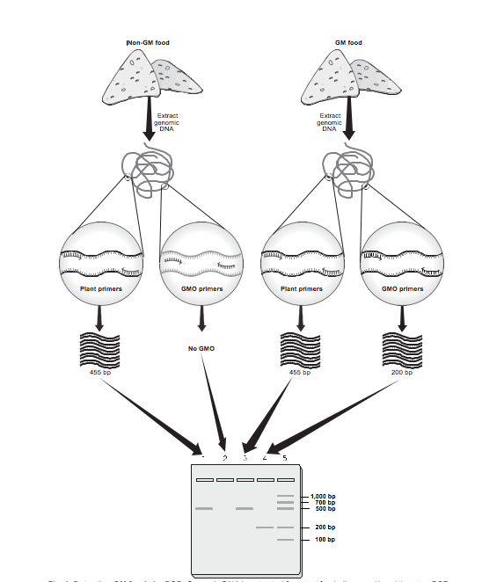
Analyze Results
Notes:
. Genomic DNA is extracted from test foods (Lesson 1) and then two PCR reactions are performed on each test food genomic DNA sample (Lesson 2). One PCR reaction uses primers specific to a common plant gene (plant primers) to verify that viable DNA was successfully extracted from the food. No matter whether the food is GM or not, this PCR reaction should always amplify DNA (See lanes 1 and 3 of the gel above). The other PCR reaction uses primers specific to sequences commonly found in GM crops (GMO primers). This PCR reaction will only amplify DNA if the test food is GM (See lane 4). If the test food is non-GM, then the GMO primers will not be complementary to any sequence within the test food genomic DNA and will not anneal, so no DNA will be amplified (see lane 2). To find out whether DNA has been amplified or not, the PCR products are electrophoresed on a gel and stained to visualize DNA as bands (Lesson 3). A molecular weight ruler (lane 5) is electrophoresed with the samples to allow the sizes of the DNA bands to be determined.

Slide 31

GMO Discussion
Groups will have 30 minutes for research and then we will have a 30 minute discussion/ presentation of your findings.

